Slide 1
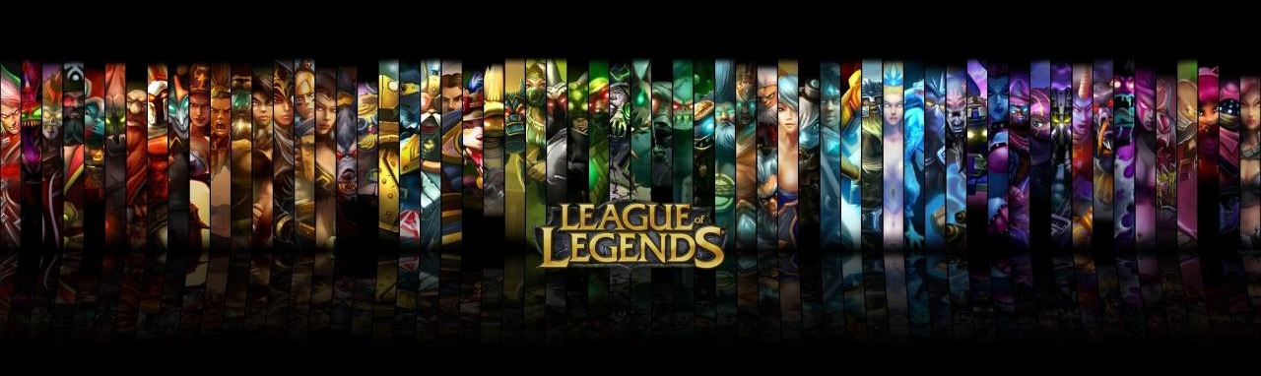
League of Legends Twitter Network Analysis
Team ULTRA
Po-Yi Du
Derek Gourley
Yazan Abu Hijleh
Menglu Pei
Yunfei Wei
Baoye Zhao

Slide 2
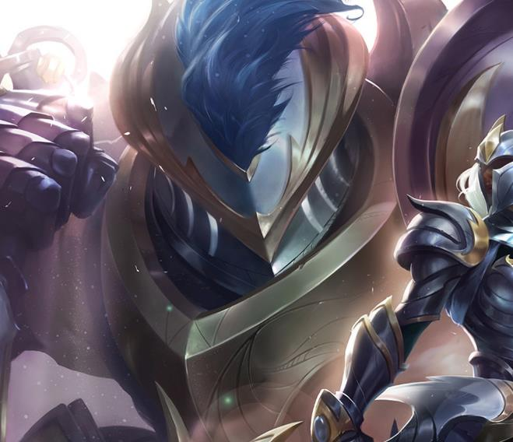
Agenda
Background
Methods
Findings
Conclusion

Slide 3
Background
What is League of Legends (LoL)?
Popular multiplayer PC game developed by Riot Games in 2009
As of September 2016, the game has 100 million monthly players.
World Championship for LoL has been held for 7 years, with total prize pool up to 5M.
Season 7 World Championship (S7) is ongoing in China in semi-final stage.
English is dominating language for League of Legends coverage.
However, Asian esport teams of LoL have won 5 out of 6 World Champions.
UK for 1, Taiwan for 1, and Korea for 4

Slide 4
Are Asian teams represented on Twitter like they are in the competitive scene?

Slide 5
Methods
We used the Twitter API for Python, Tweepy to collect:
The friends (549 in total) of the official LoL account for esport, “lolsports”.
The friend list of these 549 accounts in the result of 1.
The attributes of each of the 549 accounts.
With the collected data, we built the ego network of LoL.
The edges are only built between these 549 accounts.
We also removed the node “lolesports”.

Slide 6
Methods
In-degree
We utilized in-degree to identify influential people within the network.
We then examined the characteristics of those accounts.
Community Detection
We also utilized Community Detection to split up the nodes into groups.
We then examined the result to see if the groups share common features.

Slide 7
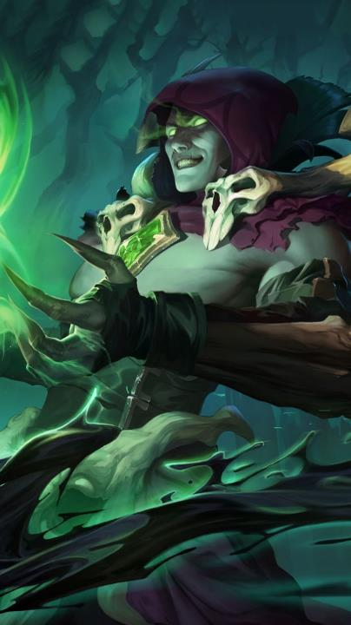
Findings

Slide 8
Average Degree: 7.845
Network Diameter: 7
*Node size is based on in degree

Slide 9
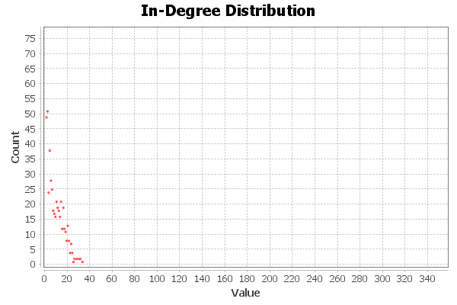
Findings: In Degree
In degree distribution
Right-skewed distribution
7 nodes have 28 or more in degree.
The nodes are:
sjokz
RiotDeficio
Bjergsen
RekklesLoL
LeagueOfLegends
riotgames
Krepo
The following table summarizes the 7 nodes.

Slide 10
Findings: In Degree
Name | Role | Region | Graph In-Degree | Twitter Follower | Twitter Following
sjokz | Presenter (NA) | Belgium/Germany | 33 | 563K | 750
RiotDeficio | Presenter (EU) | Denmark | 31 | 152K | 521
Bjergsen | MID for TSM (NA) | Denmark/USA | 31 | 1.1M | 745
RekklesLoL | ADC for FNC (EU) | Sweden/Berlin | 30 | 371K | 0
LeagueOfLegends | Official Account | ------- | 30 | 3.9M | 314
riotgames | Official Account | ------- | 28 | 1.5M | 6
Krepo | Past Presenter | Belgium | 28 | 327K | 406
Table 1. Top 7 Account by In Degree

Slide 11
Findings: Community Detection
We identified 5 groups within the original network.
4 out of 5 groups were predominantly EU and NA.
The only group with higher concentration of Asian accounts is sparsely connected.

Slide 12
Findings: Community Detection
Group | Description | Influential Accounts
1 | European/North American Professional Players and Developers. | aphromoo, RiotPhreak, RiotJatt, RiottKobe.
2 | Corporate Accounts and Official Professional Teams from EU/NA | Twitch, RiotGames, FNATIC, LeagueOfLegends
3 | Asian Teams and Sponsors | LOL_Tigers
4 | European/Korean Professional Players and Casters | G2Trick, AlphariLoL, PowerOfEvil
5 | European Coaches and Casual Players | OdoamneLoL

Slide 13
Conclusion
Top influencers are from either NA or EU.
Professional players, developers, commentators
The majority of the nodes are from NA or EU.
Game updates are usually released in English.
The Asian group is the smallest.
The connections within this group are very sparse.
If Riot wishes to expand outside NA or EU, they should consider platforms other than Twitter.

Slide 14
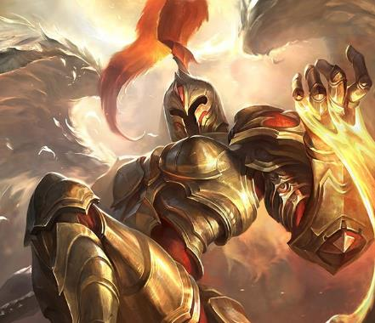
Questions?

Slide 15
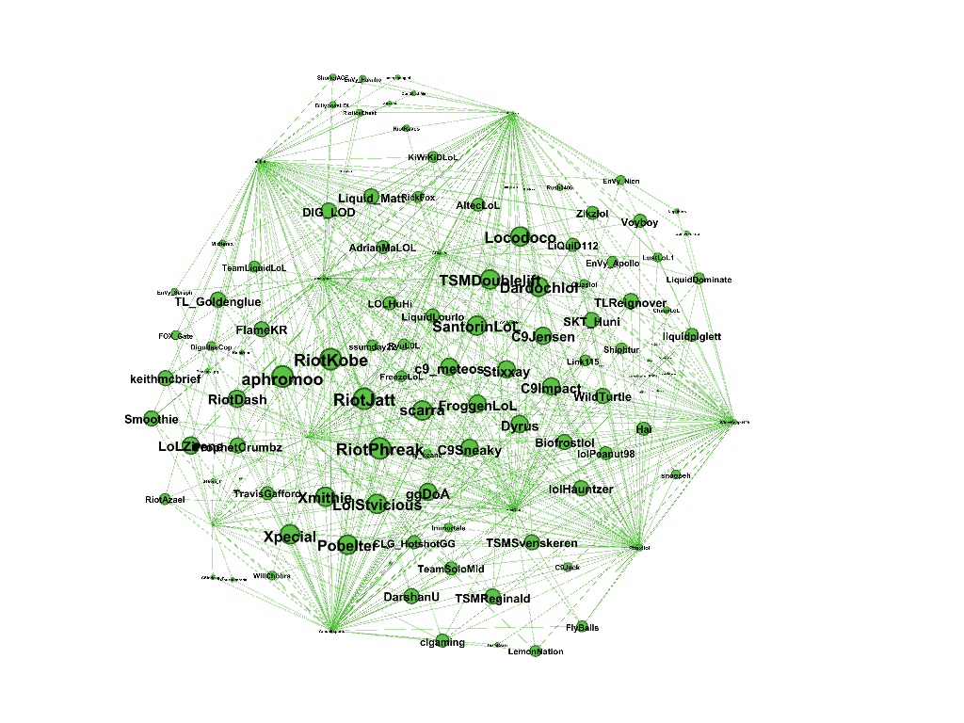

Slide 16
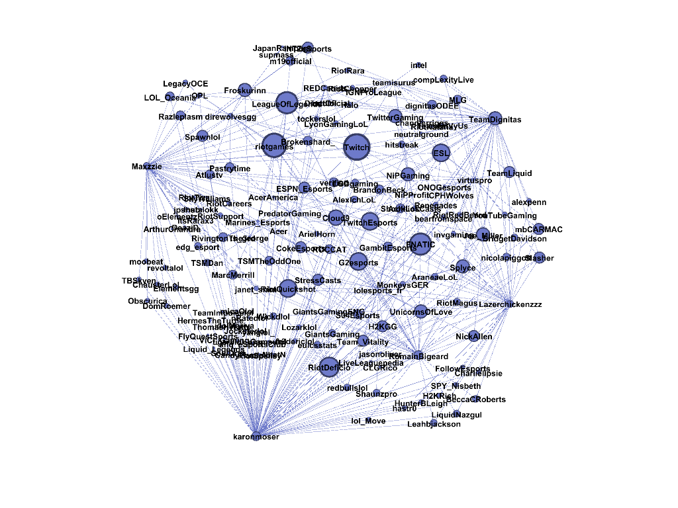

Slide 17
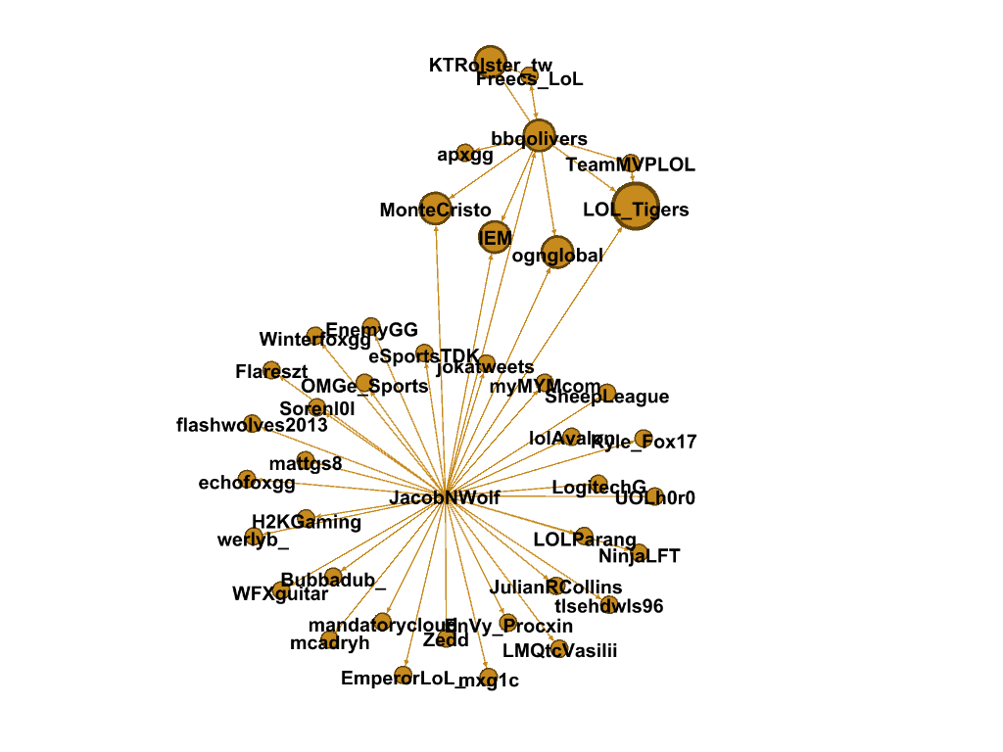

Slide 18
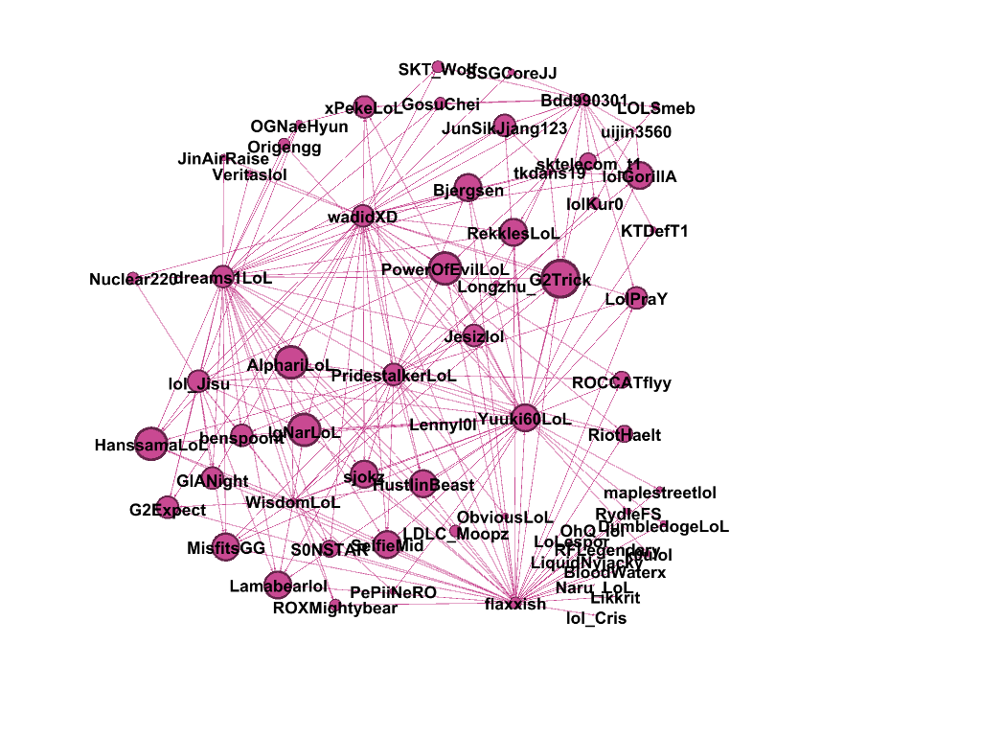

Slide 19
